Slide 1

IBM i Unit Testing Now in VS Code!
Sanjula Ganepola
Software Developer – IBM i App Dev & AI Toolchain
Sanjula.Ganepola@ibm.com
2025 February

Slide 2










What is missing in the VS Code stack?
Other
Db2 for IBM i
IBM i Renderer
Vendor Extensions
Code for IBM i
Source Orbit
IBM i Project Explorer
IBM i Languages
IBM i Debug
CL
Other Tooling
Code Coverage
RPGLE
Code Coverage
Language Extensions
Archived

Slide 3
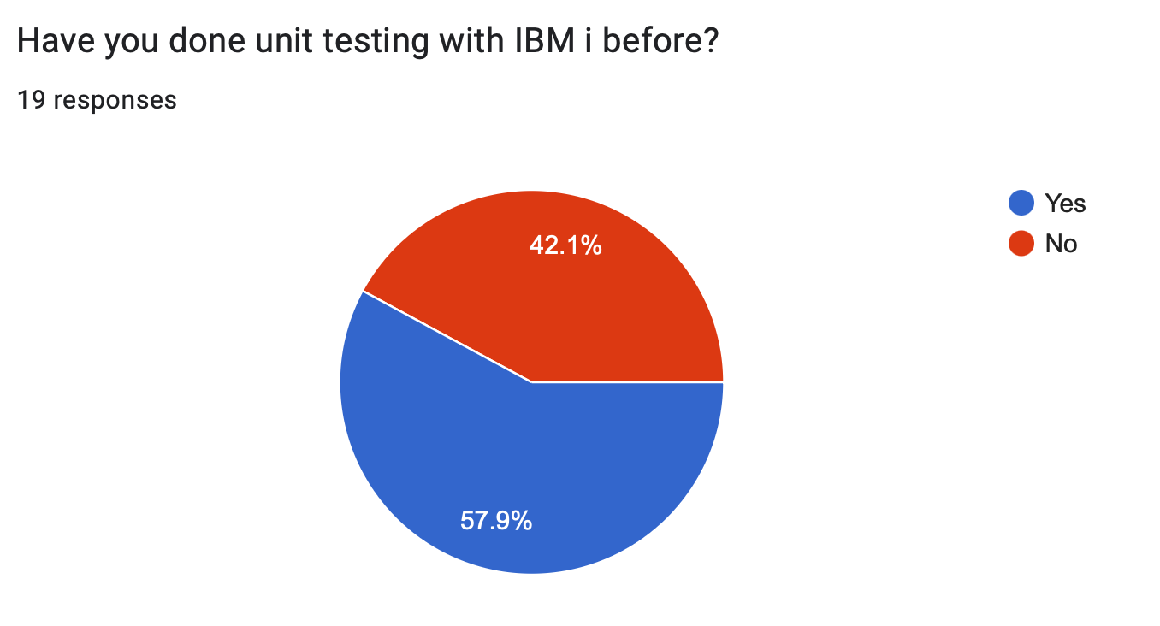
We did a survey…

Slide 4
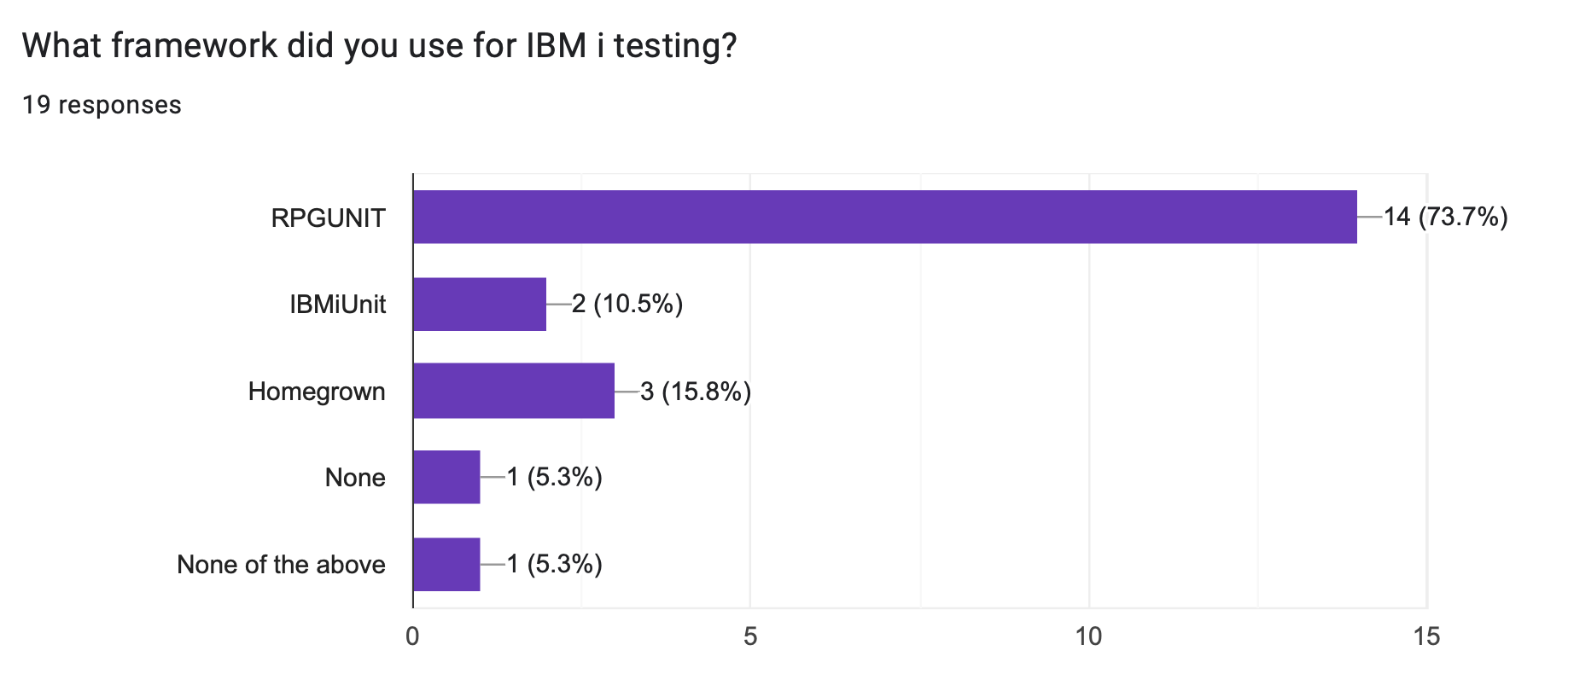
We did a survey…

Slide 5
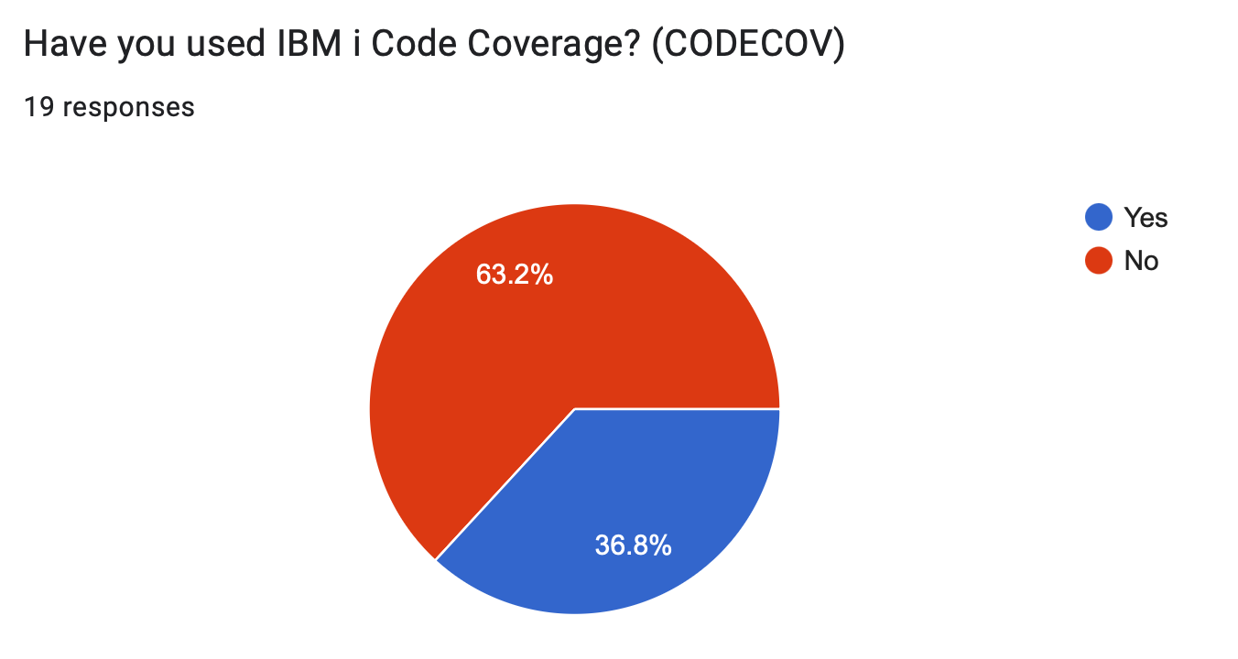
We did a survey…

Slide 6
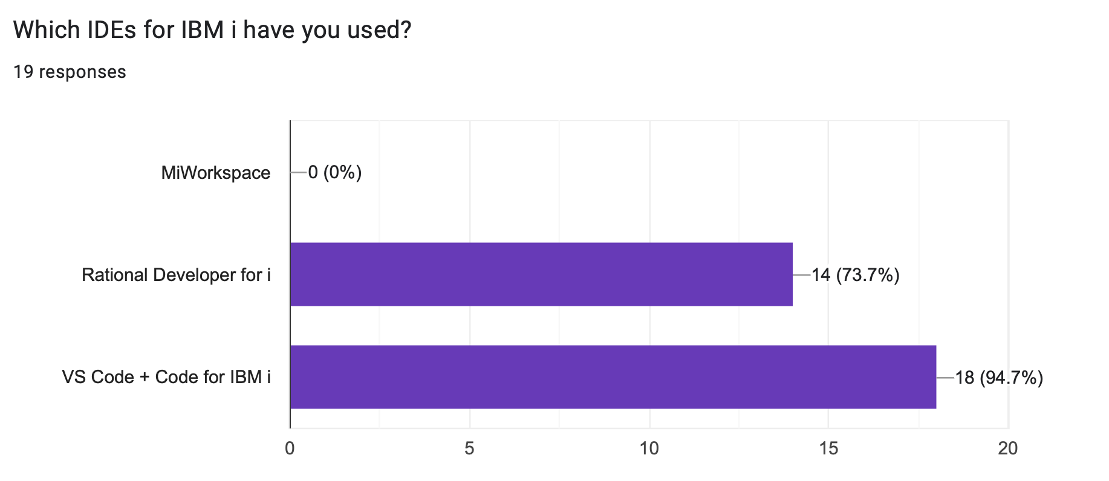
We did a survey…

Slide 7

Let’s look at the new IBM i Testing Extension

Slide 8
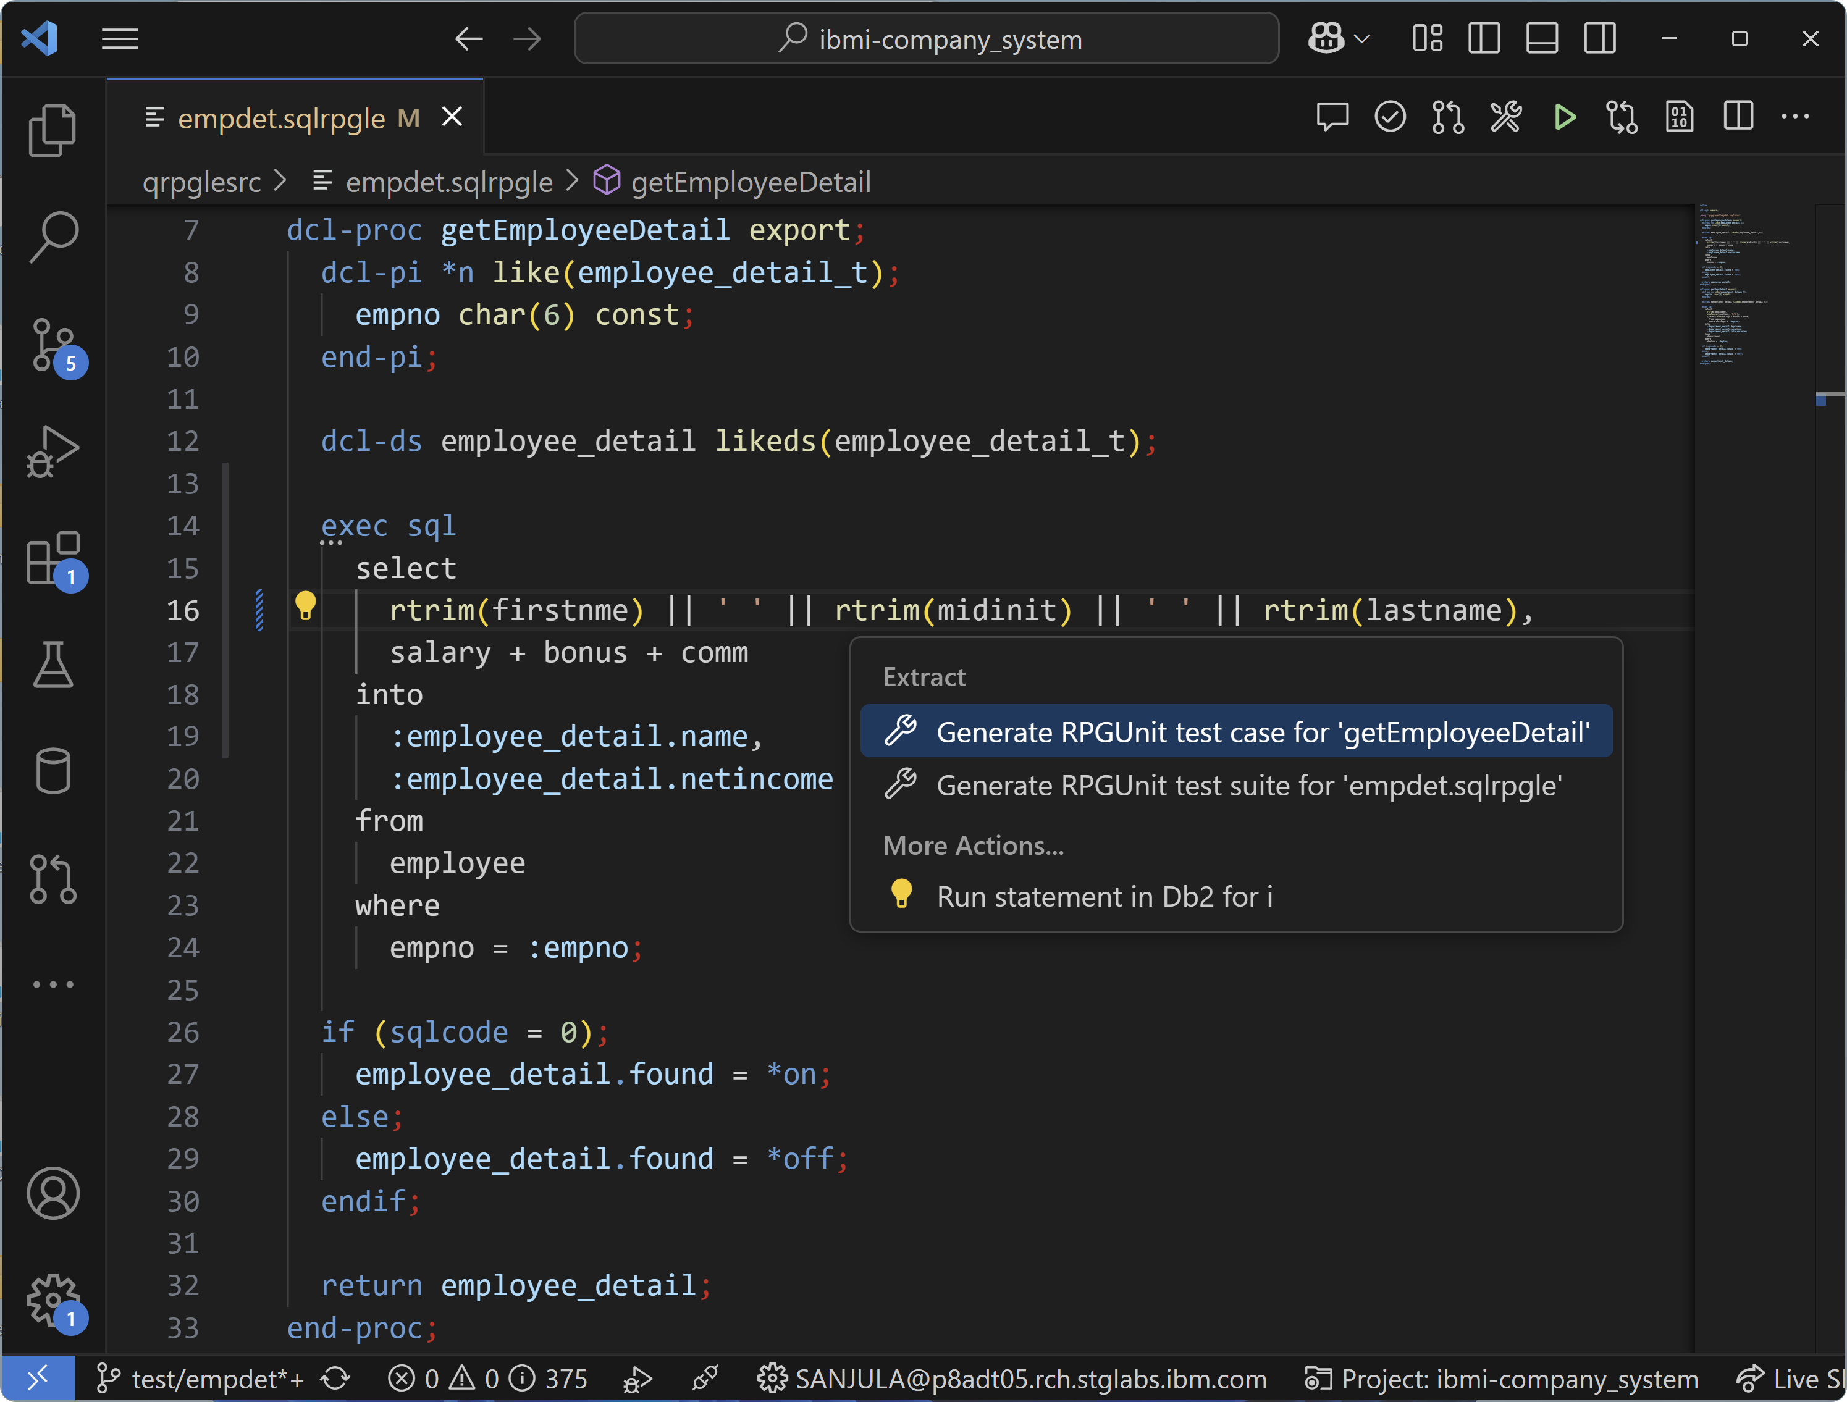
Generating test stubs

Slide 9
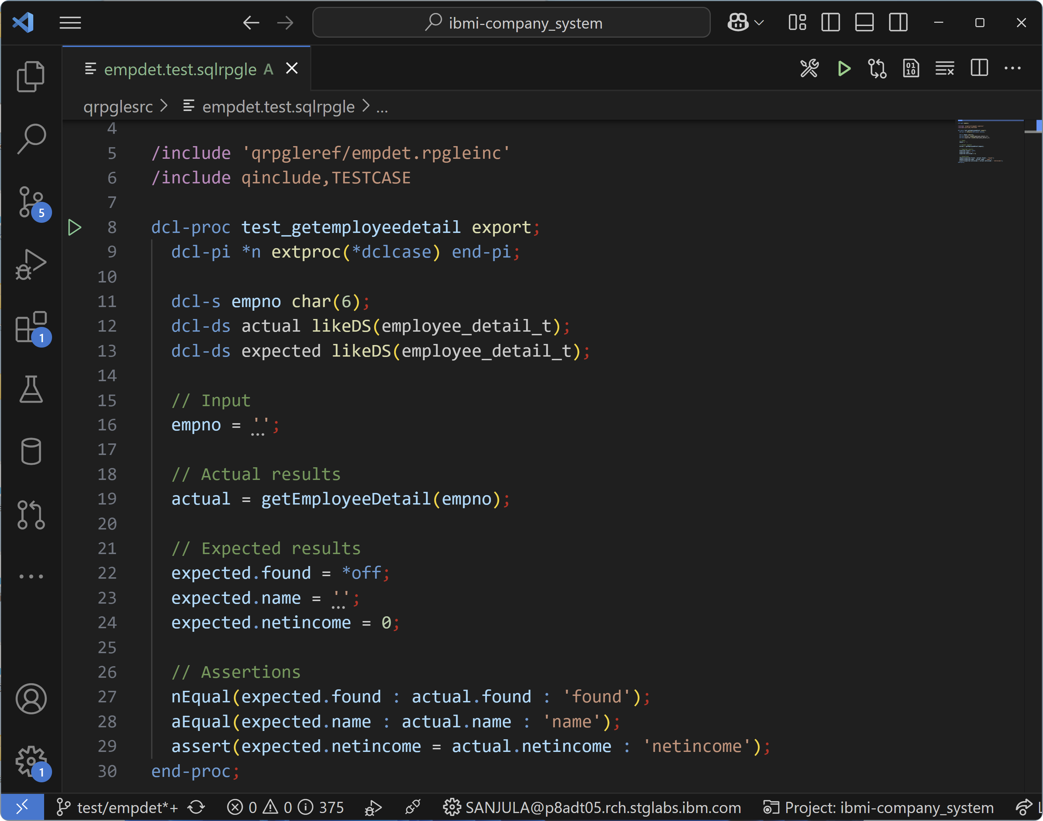
Generating test stubs

Slide 10
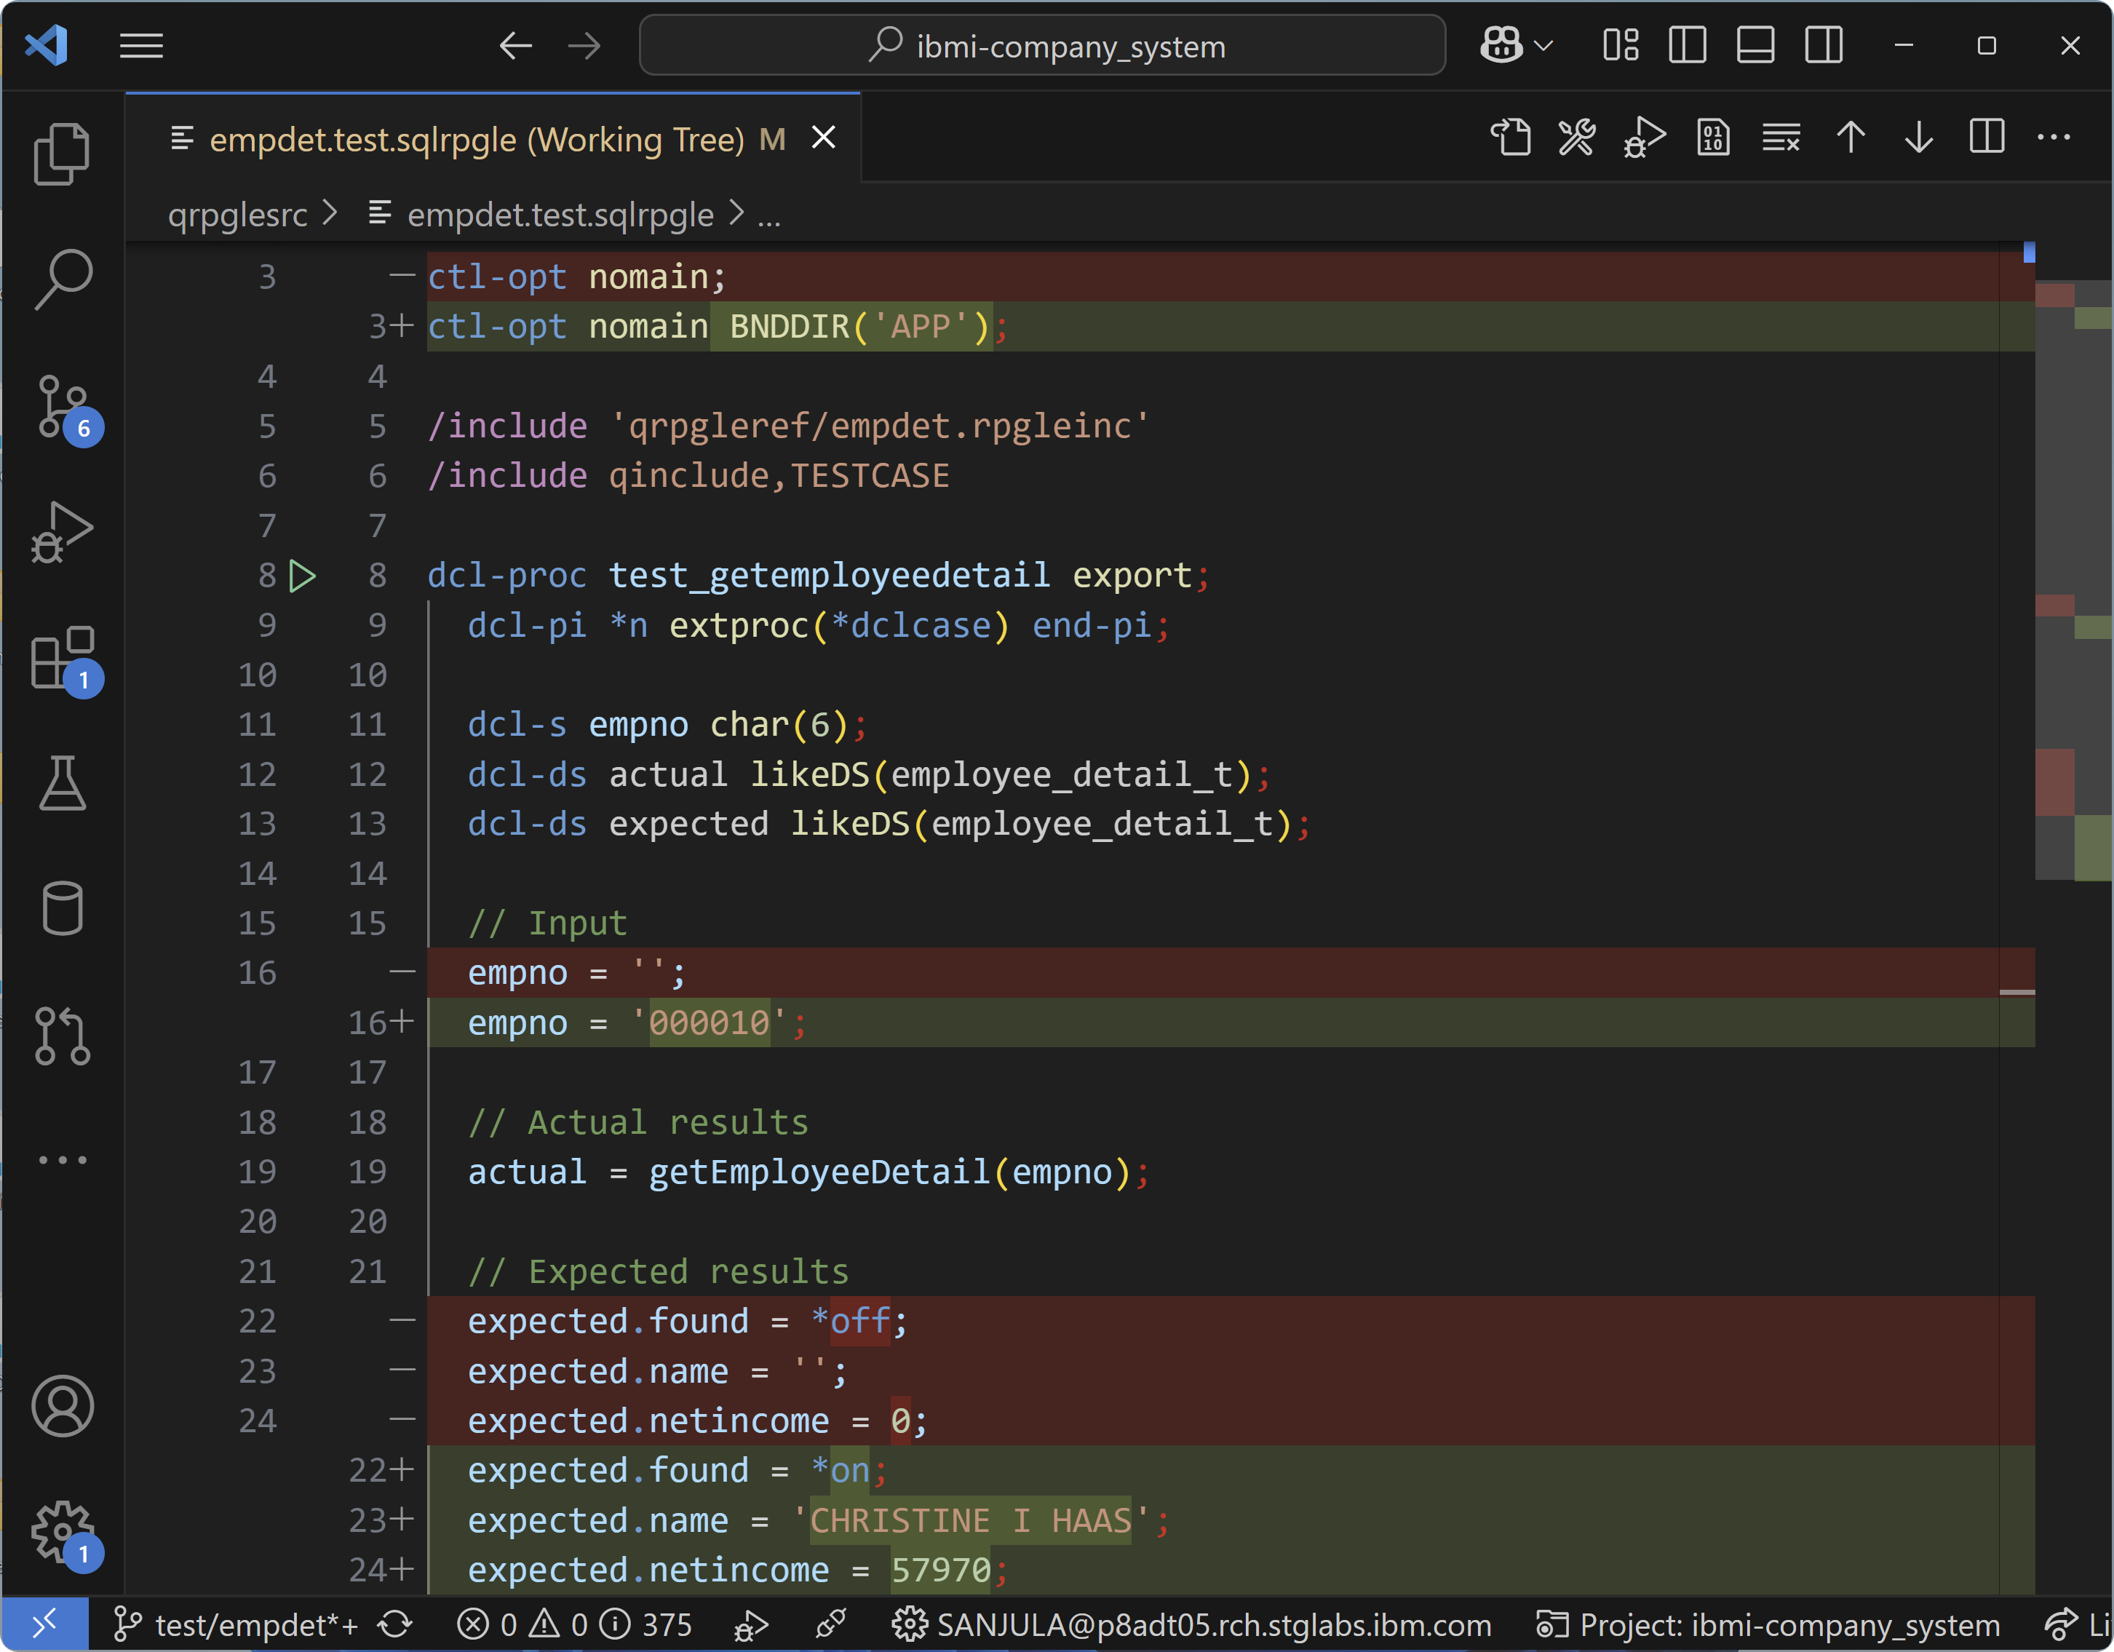
Writing Tests

Slide 11
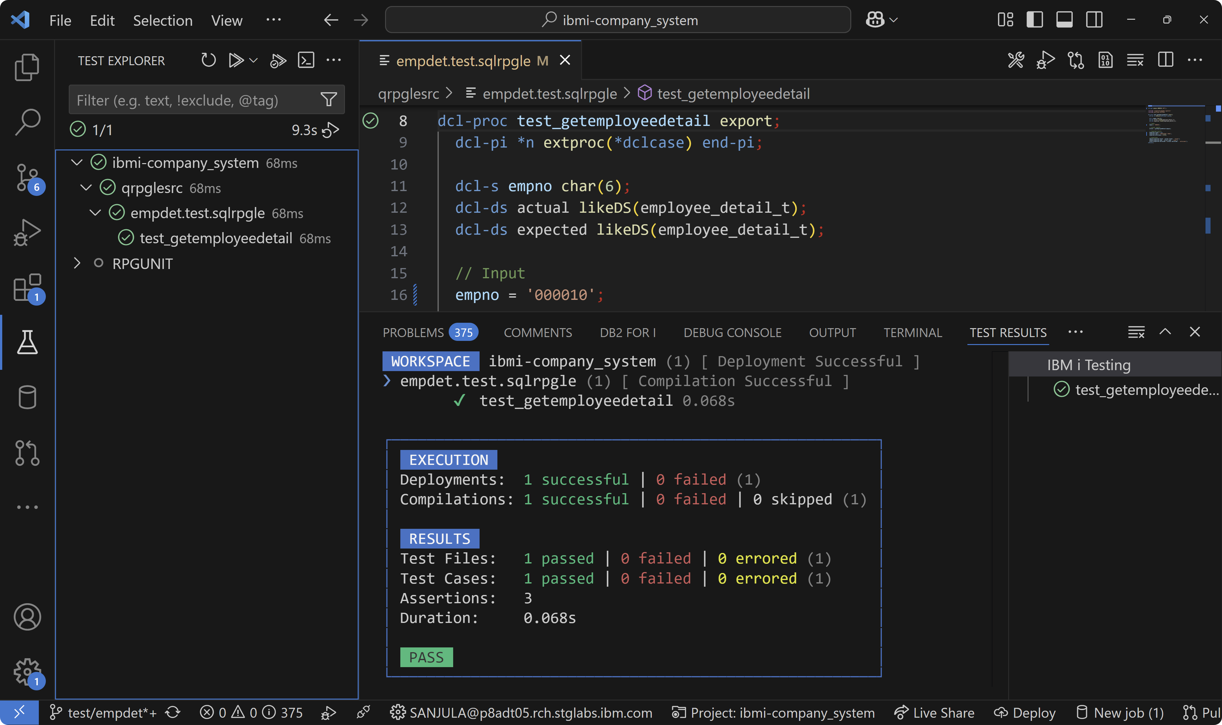
Running unit tests

Slide 12
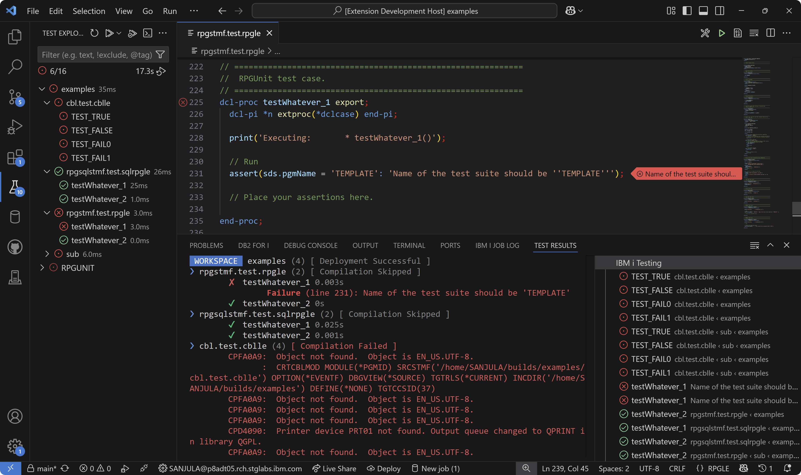
Viewing failures and errors

Slide 13
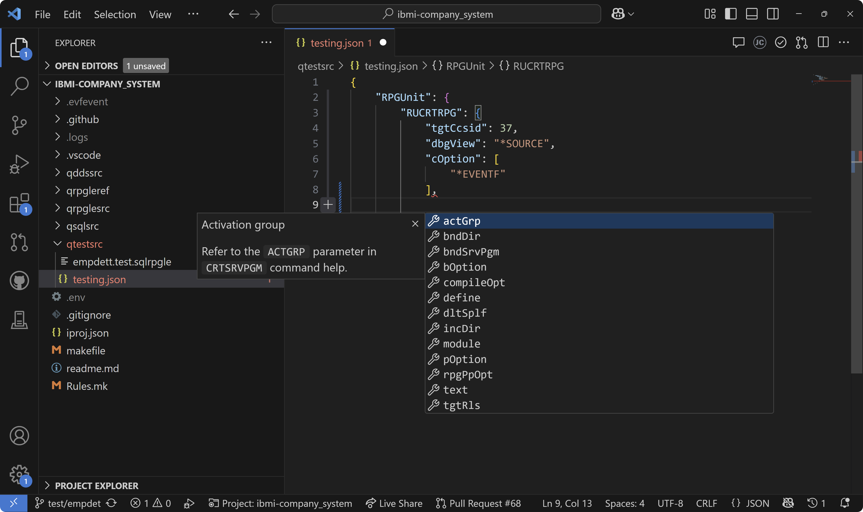
Configuring tests

Slide 14
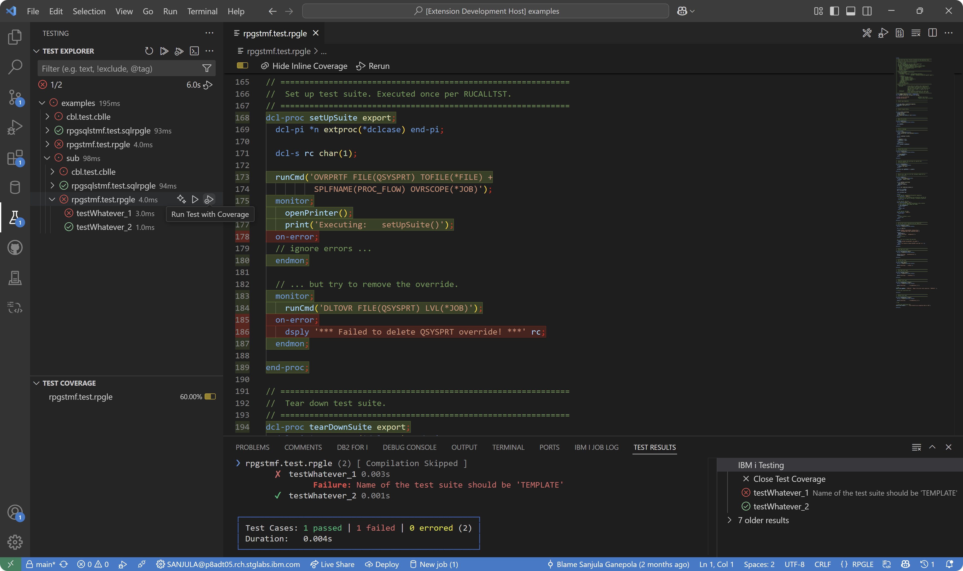
Generating code coverage

Slide 15
Important Links
IBM i Testing
VS Code Marketplace https://marketplace.visualstudio.com/items?itemName=IBM.vscode-ibmi-testing
Documentation https://codefori.github.io/docs/developing/testing/overview/
GitHub Repository https://github.com/IBM/vscode-ibmi-testing
RPGUNIT
Documentation https://irpgunit.sourceforge.io/help/
GitHub Repository https://github.com/tools-400/irpgunit
Sample Projects With Unit Tests
Company System https://github.com/IBM/ibmi-company_system
RPGUTILS https://github.com/IBM/vscode-ibmi-testing/tree/main/examples/rpg-utils
VS Code
Documentation https://code.visualstudio.com/docs/editor/testing

Slide 16
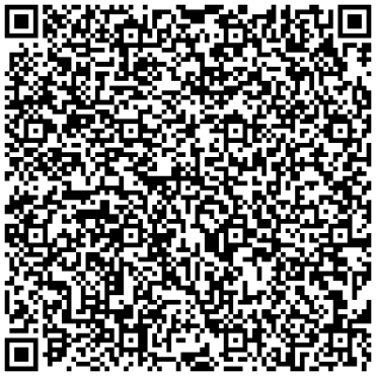
Sanjula Ganepola - IBM i Unit Testing Now in VS Code!
Please take the last minute of this session to complete the evaluation. A direct link to the evaluation can be found using the QR code to the right.

